Slide 1
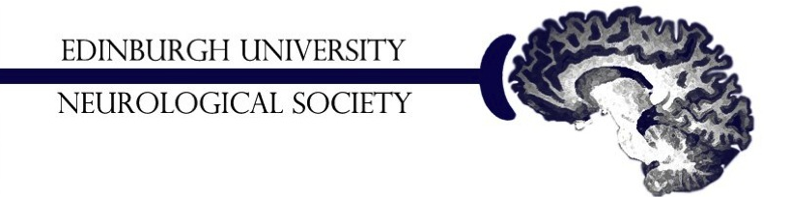
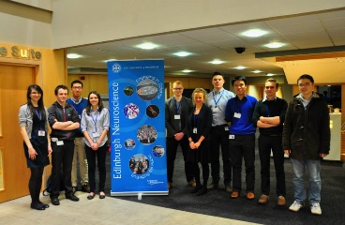
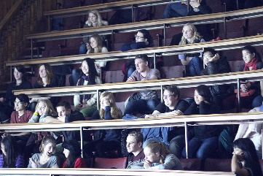
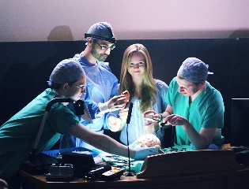
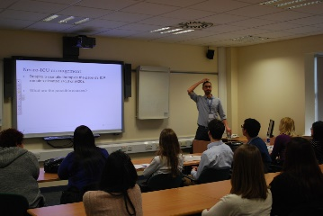
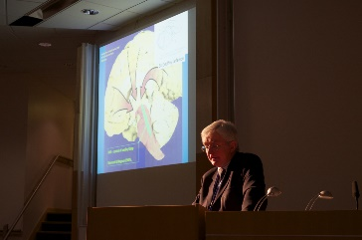
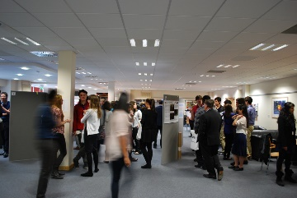
Second Year MBChB Neuroscience Revision
Edinburgh University Neurological Society
Top Hat course code: 146089

Slide 2
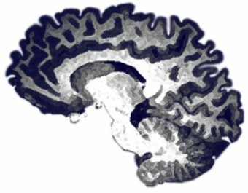
About Us
Talks
Basic Neuroscience
Clinical Neuroscience
Careers
Study:
Neuroanatomy Lecture Series
Building on the Basics
Neurosurgical tutorials
MBChB Revision
Support
For all the information visit http://www.euns.co.uk/

Slide 3
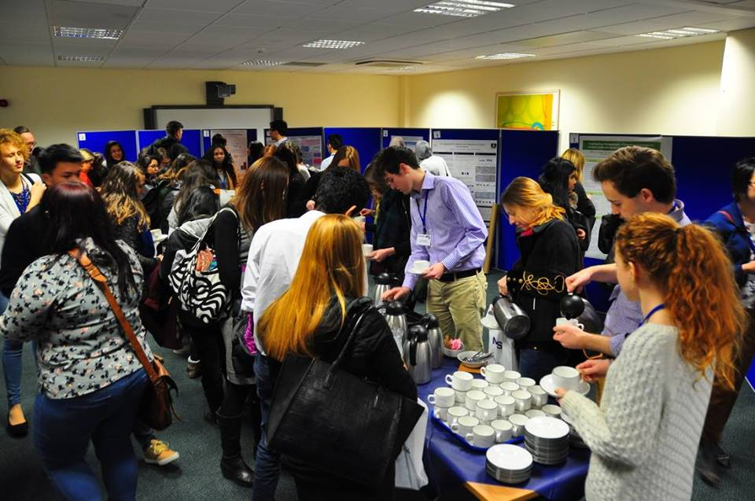
The EUNS 5th National Annual Conference!
An opportunity to learn more about a career in neurology and neuroscience! Enter our essay competition or present your own research
For information, please visit the EUNS website or fb event page: www.euns.co.uk/neuroscience-to-neurology-national-conference.html

Slide 4
We Can’t Cover Everything
Basic neural signalling
The autonomic nervous system
Neuropharmacology
Sensory transduction
Sensory pathways
Motor systems
Cortical functions
Development of the nervous system
Diseases of the motor system
Peripheral neuropathies
Special senses
Reflex arcs
CNS neoplastic disease
The ventricular system, ICP, hydrocephalus and herniation
Clinical examination of the nervous system
Neuroinflammatory disease
Infections of the nervous system
Cerebrovascular disease
Dementia
Diseases of the cord
Seizure and epilepsy
Lumbar puncture
Psychiatry

Slide 5
Part 1
Alice Mckinnes
a.mckinnes@hotmail.co.uk

Slide 6
Cranial Nerves
Where is the nuclei of the Optic Nerve (II)?
A. Midbrain
B. Pons
C. Medulla
D. Forebrain
Notes:
Cranial nerves – just something that you have to learn !

Slide 7
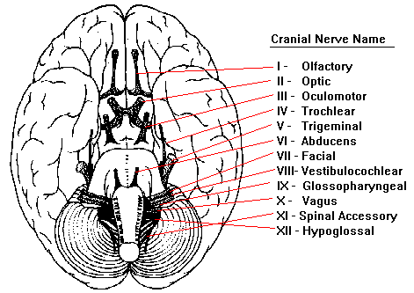
Forebrain
Midbrain
Pons
Medulla

Slide 9
Cranial Nerves
Which of these cranial nerve(s) crosses over?
Optic
Optic and Olfactory
Optic and Trigeminal
Optic and Trochlear
Optic and Hypoglossal

Slide 10
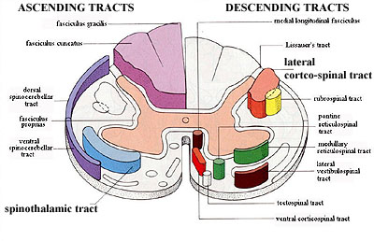
Spinal Cord
Which column is being pointed out in this section of the spinal cord?
Spinothalamic Tract
Rubrospinal Tract
Corticospinal Tract
Dorsal Column
Spinocerebellar Tract
X
Notes:
Motor control of limbs

Slide 11
Spinal Cord
Which is the condition that specifically affects this column?
Transverse Myelitis
Motor Neuron Disease
Friedreich’s Ataxia
Guillain-Barre Syndrome
Tabes Dorsalis
X
Notes:
syphilitic myelopathy
Proprioception, vibration and fine touch

Slide 12
Spinal Cord
Which of these are true, and which are false, regarding the dorsal columns?
They carry information on proprioception, fine touch, and vibration.
The cell bodies of primary neurons are found in the DRG.
The centrally projecting axons of primary neurons ascend ipsilaterally.
The fasciculus cuneatus carries sensory information from the lower limbs.
The centrally projecting axons of primary neurons decussate at the medulla.
Notes:
True
True
True, they all do
False, this is carries the sensory information from the arms, Fasciculus Gracilis does the middle thoracic and lower limbs. (graceful – walking)
True

Slide 13
Spinal Cord
Which of these are true, and which are false, regarding the spinothalamic tracts?
They carry subconscious information about pain and temperature
Centrally projecting axons from first order neurons decussate at approximately the level at which they enter the cord
Second order cell bodies are found in the nucleus gracilis and the nucleus cuneatus
In the brainstem axons of the spinothalamic tract are carried by the medial lemniscus
Axons of second order neurons terminate in the VP nucleus of the thalamus
Notes:
True
True
False, that is dorsal column
False, dorsal columns
True, receives neuronal input from the medial lemniscus, spinal lemniscus, spinothalamic tracts, and trigeminothalamic tract. It projects to the somatosensory cortex and the ascending reticuloactivation system.

Slide 15
The Motor Unit
What are the components of the motor unit?
Motor Cortex, and Cerebellum
Motor Cortex, and UMN
Motor Cortex, UMN, LMN, and Muscle Fibres
UMN, LMN, and Muscle Fibres
LMN, and Muscle Fibres

Slide 16
UMN vs LMN
Why might a stroke usually only affect only the lower part of the face (mouth and nose), whereas Bell’s Palsy affects both the lower and upper parts?

Slide 17
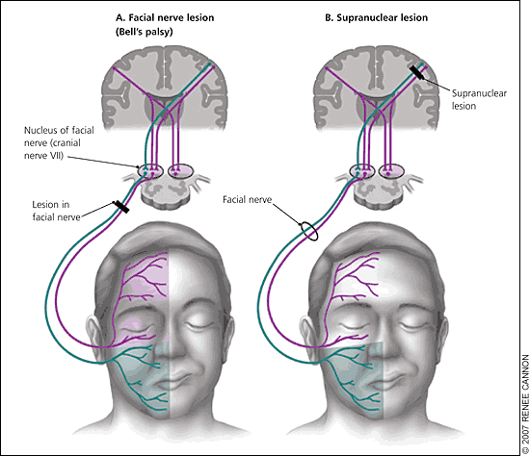

Slide 19
A woman was brought to the ED by her husband after she complained about numbness on her face.
A neurological exam showed loss of pain and temperature sensation on the RIGHT face and the LEFT body.
A lesion causing these symptoms would be located in:
A. Right postcentral gyrus
B. Medial part of the rostral medulla on the right
C. Lateral part of the rostral medulla on the right
D. Right trigeminothalamic tract
E. Lateral part of the rostral pons on the left

Slide 20
A 59 year old patient presents with a lumbar spinal lesion on the left side of the cord with no damage to the right side. Which of the following will be seen during examination:
A. Patient will have no sensation on left but full sensation on the right
B. Loss of vibration sense on the right, loss of pain sensation on the left
C. Loss of proprioception and vibration on both sides
D. Patient cannot localise touch on left side with loss of pain sensation on right
Notes:
Pain sensation contralateral
Fine touch ipsilateral

Slide 21
Which of the following clinical presentations is most consistent with a diagnosis of syringomyelia?
Unilateral loss of motor function
Bilateral loss of motor function
Loss of pain and temperature unilaterally
Loss of pain and temperature bilaterally
Loss of proprioception and discriminative touch unilaterally
Loss of proprioception and discriminative touch bilaterally
Notes:
The first thing you need to know to answer this question is that syringomyelia results in an enlarged central canal which compresses decussating axon tracts. If you knew that the ventral white commissure specifically was affected and that this structure contains decussating axons of the spinothalamic tracts you were almost at the answer. If you only knew that the central canal was enlarged and that this would likely affect axons decussating at the cord level you could have worked it out. In addition, you can rule out all the unilateral answers as expansion of the central canal is going to effect decussating axons passing in both directions.
Motor function to the in the cord is carried by the corticospinal tracts. Most axons descend in the lateral corticospinal tracts which decussate at the level of the medulla and thus would be unaffected by the enlarged central canal.
Pain and temperature are carried to the brain via the spinothalamic tracts and the axons of the second order neurons in the dorsal horn decussate at that level through the ventral white commissures and ascend contralaterally. The ventral white commissure is damaged in syringomyelia by the enlarged central canal and this results in a loss of pain and temperature sensation on both sides.
Proprioception and discriminative touch are carried by the dorsal columns. The axons in the dorsal columns do not decussate until the level of the medulla so are unlikely to be affected by the enlarged central canal.

Slide 22
Part 2
Hui Yen Teh
s1401644@sms.ed.ac.uk

Slide 23
Peripheral Nerves
Structure
Peripheral Nerve Disorders
Wikimedia Commons

Slide 24
Structure
Notes:
Describe the structure of a peripheral nerve
Peripheral Nerve – all the nerve trunks and branches that lie outside the CNS
A typical peripheral nerve consists of numerous nerve fibres, which may be either efferent or afferent
Some are myelinated and some are unmyelinated
The nerve fibres within peripheral nerves are arranged in bundles and surrounded by sheaths of connective tissue
Endoneurium – between individual fibres
Perineurium – surrounds bundles of fibres
Epineurium – tough, ensheaths whole nerve

Slide 25
Peripheral Nerves
Which of the following is a feature of a lesion of the ulnar nerve?
Wrist drop
Carpal tunnel syndrome
Erb’s palsy
Claw-hand deformity
Notes:
Wrist drop (radial nerve lesion) Carpal tunnel (median nerve lesion) Claw hand deformity (ulnar nerve) Erb’s palsy (upper roots of brachial plexus)
Brachial Plexus lesions
Trauma causing avulsion of the brachial plexus causing immediate weakness and loss of feeling in one upper limb
The arm then wastes and becomes painful
Traction lesions – Upper roots (C5 and C6) – Erb’s palsy. ‘Waiter’s tip’ position of the arm
Lower roots (C8 and T1) – claw-hand deformity
Pancoate’s syndrome
Tumour of the apex of the lung can infiltrate the lower part of the brachial plexus
Severe pain in the arm, weakness and wasting of the hand and sensory loss on the inner aspect of the forearm and hand

Slide 26
Peripheral Nerves
Which of the following is a feature of a lesion of the ulnar nerve?
Wrist drop
Carpal tunnel syndrome
Erb’s palsy
Claw-hand deformity
Notes:
Pancoast tumour Wrist drop Median nerve carpal tunnel Ulnar nerve – claw hand deformity Erb’s palsy
Brachial Plexus lesions
Trauma causing avulsion of the brachial plexus causing immediate weakness and loss of feeling in one upper limb
The arm then wastes and becomes painful
Traction lesions – Upper roots (C5 and C6) – Erb’s palsy. ‘Waiter’s tip’ position of the arm
Lower roots (C8 and T1) – claw-hand deformity
Pancoate’s syndrome
Tumour of the apex of the lung can infiltrate the lower part of the brachial plexus
Severe pain in the arm, weakness and wasting of the hand and sensory loss on the inner aspect of the forearm and hand
Brachial plexus neuropathy
Acute inflammation of the brachial plexus
Severe pain, weakness and sensory losing one arm
Usually recovers after a year
Lumbosacral plexus lesions
Damaged by malignant disease and surgical procedures for cancer
Pain, weakness and wasting of the muscles and numbness of the legs. Bladder and bowel incontinence
Radial Nerve (C6-C8)
Damaged by fractures to the mid-shaft of humerus
Compression at same site leading to ‘Saturday night paralysis’ – loss of extenstion of the wrist and fingers (wrist drop)
Median Nerve (C5-T1, predominantly C6)
Carpal Tunnel Syndrome – predominantly sensory but may be associated with wasting of thenar muscles
Ulnar Nerve (C7, C8, T1)
May be damaged by injury at the medial epicondyle of the elbow or at the medial aspect of the wrist. “Claw-hand” deformity
Femoral Nerve (L2-L4)
May be damaged by hip dislocation, pelvic fracture and tumours in the pelvis
Leads to weakness of knee extension (results in inability to lock knee while walking) and some of the quadriceps
Sciatic Nerve
Sciatica – Compression or irritation of a spinal root which comprises the sciatic nerve
L5 – sensory: pain in posterolateral thigh and leg, numb inner foot. Motor: weakness of dorsiflexing foot and toes
S1 – Sensory: pain in posterolateral thigh and leg, numb lateral foot. Motor: weakness of foot dorsiflexion and loss of ankle jerk
Rare – L3 and L4- diminished knee jerk, pain in anterior thigh
Common Peroneal Nerve (L4-S2)
Can be damaged as it winds round the head of the fibula. This can be by fracture or compression eg tight cast
Results in weakness of foot dorsiflexion and eversion

Slide 27
Peripheral Nerve Lesions
NERVE | MECHANISM OF INJURY | FEATURE
Radial nerve | Fracture of midshaft of humerus | Loss of sensation of dorsal aspect of hand Wrist drop
Median nerve | Wrist fracture, endocrinopathies (thyroid dysfunction, diabetes) | Carpal tunnel syndrome (lateral 3.5 fingers – palmar aspect) Wasting of thenar muscles
Ulnar nerve | Elbow fracture (medial epicondyle), wrist fracture | Loss of sensation of medial 1.5 fingers Claw hand deformity
Sciatic nerve | Compression of nerve root (sciatica), pelvic fracture | Pain in posterior thigh, Sensory loss below knee Foot drop and loss of knee flexion
Common peroneal nerve | Fracture of fibular neck, excessive compression (tight plaster cast) | Sensory loss of central dorsum of foot and lower lateral leg Foot drop and loss of eversion
Notes:
Much easier to remember if you remember anatomy well – which nerve supplies which muscle compartment and area of sensation Radial Nerve (C6-C8)
Damaged by fractures to the mid-shaft of humerus as it winds around the radial groove of the humerus
Compression at same site leading to ‘Saturday night paralysis’ – loss of extension of the wrist and fingers (wrist drop) sensation is tested by touching first dorsal web space
Median Nerve (C5-T1, predominantly C6)
only nerve that passes through carpal tunnel of the hand – prone to injury whenever pressure in the carpal tunnel space increases due to whatever reason
Carpal Tunnel Syndrome – predominantly sensory but may be associated with wasting of thenar muscles which mostly provides motor fx to thumb sensation is tested by touching tip of index finger
Ulnar Nerve (C7, C8, T1)
May be damaged by injury at the medial epicondyle of the elbow or at the medial aspect of the wrist. “Claw-hand” deformity
Femoral Nerve (L2-L4)
May be damaged by hip dislocation, pelvic fracture and tumours in the pelvis
Leads to weakness of knee extension (results in inability to lock knee while walking) and some of the quadriceps
Sciatic Nerve
Sciatica – Compression or irritation of a spinal root which comprises the sciatic nerve
L5 – sensory: pain in posterolateral thigh and leg, numb inner foot. Motor: weakness of dorsiflexing foot and toes
S1 – Sensory: pain in posterolateral thigh and leg, numb lateral foot. Motor: weakness of foot dorsiflexion and loss of ankle jerk
Rare – L3 and L4- diminished knee jerk, pain in anterior thigh
Sciatic nerve supplies muscles in posterior thigh (hamstring) and also divides into common peroneal nerve and tibial nerve so would also result in foot drop
Common Peroneal Nerve (L4-S2)
Can be damaged as it winds round the head of the fibula. This can be by fracture or compression eg tight cast
Supplies the muscles in the lateral compartment of leg (which are the everters of foot)
Results in weakness of foot dorsiflexion and eversion (high stepping gait)

Slide 28
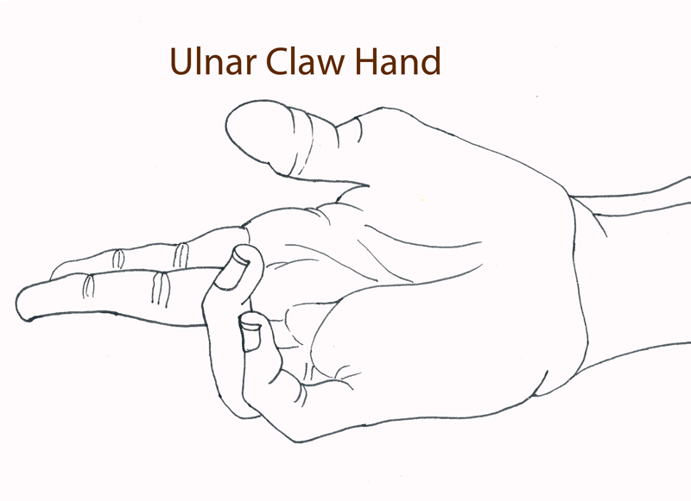
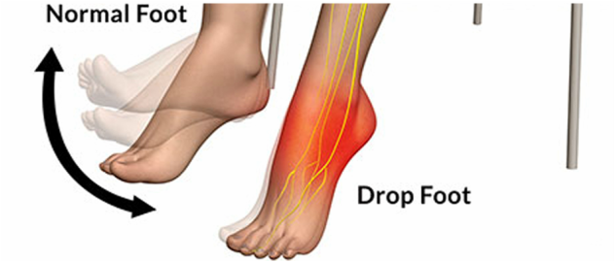

Slide 29
CNS Infections
Meningitis - Bacterial - Viral
Encephalitis - Usually viral
Cerebral abscess - Bacterial
Notes:
Meningitis : inflammation of the arachnoid and pia mater and spinal fluid - bacterial tends to have specific kinds of bacteria for different age groups; clinically rapidly fatal without treatment - viral cause of meningitis is common, severe headache but self-limiting and full recovery
Encephalitis : inflammation of brain parenchyma - usually viral and severe with neurologic sequelae
Cerebral abscess : localized collection of pus within brain parenchyma

Slide 30
A 20 year old female presented to her GP with a severe headache. On further questioning, she also admitted to having a stiff neck and dislike of bright lights recently. What organism would you suspect if the cause of her condition is bacterial in origin?
Listeria monocytogenes
E. Coli
Neisseria meningitidis
Herpes simplex
Notes:
What are the symptoms suggestive of?

Slide 31
A 20 year old female presented to her GP with a severe headache. On further questioning, she also admitted to having a stiff neck and dislike of bright lights recently. What organism would you suspect if the cause of her condition is bacterial in origin?
Listeria monocytogenes
E. Coli
Neisseria meningitidis
Herpes simplex
Notes:
What are the symptoms suggestive of?

Slide 32
Notes:
As a rule of thumb, remember common bacteria for children and adults are streptococcus pneumoniae and neiserria meningitidis; important one to remember for neonates and elderly is Listeria

Slide 33
CSF Analysis
Notes:
Note that in viral infections, innate immune system is not involved; primarily cleared by adaptive immune system so there would be lymphocytes instead of neutrophils
Reduced glucose is result of bacteria using up glucose for their metabolism

Slide 34
Which of the following would you consider to be abnormal of the CSF?
Colourless fluid
Protein
Glucose
Lymphocytes
Neutrophils
Notes:
Lateral ventricle → Interventricular foramen of Monro → 3rd ventricle → Cerebral aqueduct → 4th ventricle → Median aperture (foramen of Magendie) → Cisterna magna → Subarachnoid space → Dural venous sinuses
→ Lateral apertures (foramen of Luschka) → Subarachnoid space in cerebellopontine angle region
Most likely to get blocked at cerebral aqueduct

Slide 35
Which of the following would you consider to be abnormal of the CSF?
Colourless fluid
Protein
Glucose
Lymphocytes
Neutrophils

Slide 36
CSF
Composition : - Mostly water (99%) - Contains few cells (eg: lymphocytes), glucose, protein and electrolytes - Presence of RBCs and neutrophils is ABNORMAL

Slide 37
CSF Circulation
Notes:
Lateral ventricle (produced in choroid plexus) → Interventricular foramen of Monro → 3rd ventricle → Cerebral aqueduct → 4th ventricle → Median aperture (foramen of Magendie) and lateral apertures (foramen of Luschka) → Subarachnoid space → Dural venous sinuses

Slide 38
Which statement incorrectly describes the Glasgow Coma Scale?
The lowest score anyone can receive is 3
The score is calculated by assessing eye opening, verbal response and motor response
The highest point one can receive for motor response is 5
A GCS score of 6 indicates severe injury and coma

Slide 39
Which statement incorrectly describes the Glasgow Coma Scale?
The lowest score anyone can receive is 3
The score is calculated by assessing eye opening, verbal response and motor response
The highest point one can receive for motor response is 5
A GCS score of 6 indicates severe injury and coma

Slide 40
Glasgow Coma Scale
Response | Scale | Score
Eye Opening | Spontaneous To command To pain None | 4 3 2 1
Verbal Response | Orientated Confused Words Sounds None | 5 4 3 2 1
Motor Response | Obeys commands Localises pain Flexion/withdrawal Abnormal flexion Extends to pain None | 6 5 4 3 2 1
GCS less than 8 = Coma
Highest = 15 Lowest =3

Slide 41
Part 3
Scott Morrison
s1306163@sms.ed.ac.uk

Slide 42
The Vestibular System
BONY LABYRINTH
BONE
BONE

Slide 43
The Vestibular System
BONY LABYRINTH
BONE
BONE
PERILYMPH

Slide 44
The Vestibular System
BONY LABYRINTH
MEMRANOUS LABYRINTH
BONE
BONE
PERILYMPH

Slide 45
The Vestibular System
BONY LABYRINTH
MEMRANOUS LABYRINTH
BONE
ENDOLYMPH
BONE
PERILYMPH

Slide 46
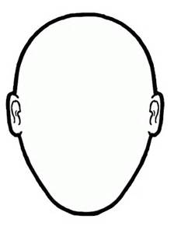
Central Connections
Four pairs of nuclei:
Superior
Medial
Lateral
Descending

Slide 47
Medial and Lateral
Medial (Ipsilateral, Maybe bilateral)
Lateral (Ipsilateral)
Up and down
Medial longitudinal fasciculus
Up to the eyes
Down to the spine (medial vestibulospinal tract)
Semicircular canals
Down
Lateral vestibulospinal tract
Semicircular canals
Otolith organs

Slide 48
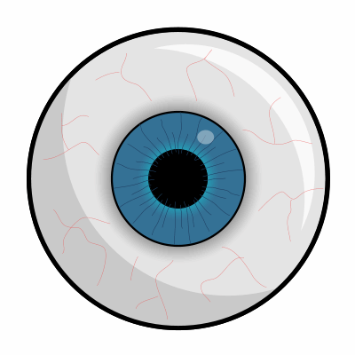
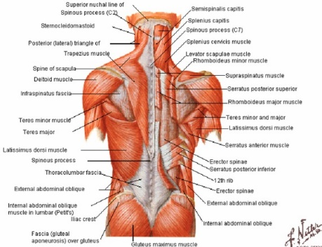
Superior Vestibular Nuclei
Four pairs of nuclei:
Superior (S)
Medial (M)
Lateral (L)
Descending (D)
Semicircular Canals
S
L
M
Otolith Organs
D

Slide 49
Inferior Vestibular Nuclei
Four pairs of nuclei:
Superior (S)
Medial (M)
Lateral (L)
Descending (D)
Semicircular Canals
S
L
M
Integration:
Other vestibular nuclei
Spinal pathways
Cerebellum
Reticular formation
Otolith Organs
D

Slide 50
Summary
Nucleus | Input | Output | Function
Medial | Semicircular canals | MLF to postural muscles and oculomotor nuclei [Predominantly excitatory] | Postural control Gaze control
Lateral | Semicircular canals Otolith organs | Lateral vestibulospinal tract | Postural control
Superior | Semicircular canals | Oculomotor nuclei [Predominantly inhibitory] | Gaze control
Descending | Otolith organs | Cerebellum Reticular formation Contralateral vestibular nuclei Spinal cord | ?Integration
I made this table based on my own sources so beware as far as Medical School exams go (though I suspect this is likely to be more accurate if anything).

Slide 51
The VOR
The vestibulo-ocular reflex (VOR) depends on all the following except:
Trochlear nucleus
Medial longitudinal fasciculus
Nystagmus
Superior vestibular nucleus
Lateral vestibular nucleus
http://neuroscience.uth.tmc.edu/s2/chapter11.html
Notes:
E - The lateral vestibular nucleus contributes to a descending, not ascending, pathway, and is thus NOT involved in the VOR.

Slide 52
A Surgical Sieve for Neurology
Congenital
Genetic
Vascular and drainage
Neoplastic
Inflammatory
Autoimmune
Degenerative
Electrical
Traumatic

Slide 53
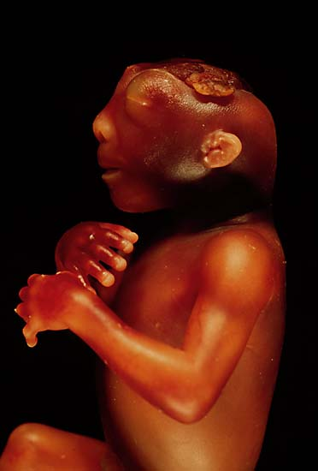
Developmental Disease
The picture below demonstrates a foetus with which of the following conditions:
Spina bifida
Anencephaly
Holoprosencephaly
Microcephaly
Arnold–Chiari malformation
Notes:
B
C – prosencephalon fails to develop into two hemispheres
E – a malformation of the skull. It consists of a downward displacement of the cerebellar tonsils through the foramen magnum (the opening at the base of the skull), sometimes causing non-communicating hydrocephalus

Slide 54
Following the Neural Tube

Slide 55
Developmental Disease 2
Which of the following statements regarding spina bifida is false:
Taking folic acid supplements is recommended before and during the first 12 weeks of pregnancy to reduce the risk of neural tube defects
Sodium valproate if taken during pregnancy increases the risk of neural tube defects
Failure of closure more commonly affects the caudal neural tube
Spina bifida occulta is defined as failure of the vertebral arches with an external cystic lesion
Neural tissue is a component of the cyst wall in a myelomeningocele
Notes:
D – no cystic lesion, just tuft of hair
C - Failure of closure of the anterior neuropore during embryogenesis will lead to anencephaly, the failure of the brain and skull to develop. Failure of closure of the posterior neuropore (caudal neuropore) during embryogenesis will lead to spina bifida.

Slide 56
Neural Tube Defects

Slide 57
Cerebrovascular Disease
You need to know:
How blood gets to the brain
Major arterial territories
The consequence of impaired supply to those territories
How blood gets out of the brain
Cerebral autoregulation physiology

Slide 58
Blood Supply to the Brain
1 is the:
Anterior cerebral artery
Posterior cerebral artery
Anterior communicating artery
Vertebral artery
Posterior inferior cerebellar artery
1
2
3
4
Notes:
A

Slide 59
Blood Supply to the Brain
2 is the:
Posterior cerebral artery
Posterior communicating artery
Superior cerebellar artery
Vertebral artery
Posterior inferior cerebellar artery
1
2
3
4
Notes:
B

Slide 60
Blood Supply to the Brain
3 is the:
Posterior cerebral artery
Superior cerebellar artery
Anterior inferior cerebellar artery
Posterior inferior cerebellar artery
Anterior spinal artery
1
2
3
4
Notes:
C

Slide 61
Blood Supply to the Brain
4 is the:
Internal carotid artery
Basilar artery
Vertebral artery
Anterior spinal artery
Posterior spinal artery
1
2
3
4
Notes:
D

Slide 62
For fun?
http://www.purposegames.com/game/circle-of-willis-challenge-quiz

Slide 63
Vascular Territories

Slide 64
In Practice
Mr Smith is a 66 year old right handed man who presents to the ED. He has a history of vascular risk factors. CT demonstrates infarction in the territory of the left middle cerebral artery. Which of the following features would Mr Smith have been most likely to initially present with?
Dysphagia
Headache
Left sided arm weakness
Right homonymous hemianopia
Right lower quadrant facial weakness
Notes:
E
Dysphasia and dysphagia – not to be confused
Headache is not very common in stroke – though more so with haemorrhagic strokes
Left hemisphere controls the right side so left sided arm weakness would not occur
RHH is due to a left occipital stroke

Slide 65
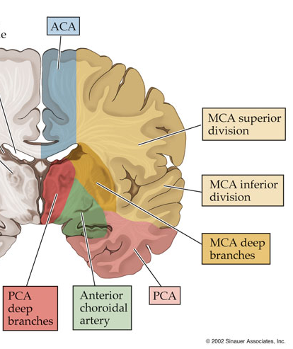
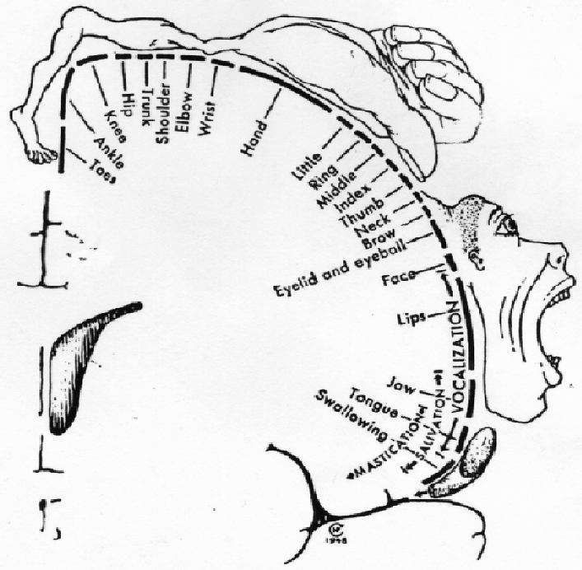
The Motor Homunculus

Slide 66
Venous Drainage of the Brain
Superior sagittal sinus
Sigmoid sinus
Great cerebral vein
Straight sinus
Confluence of the sinuses
Transverse sinus
Cavernous sinus
A
A
Notes:
F

Slide 67
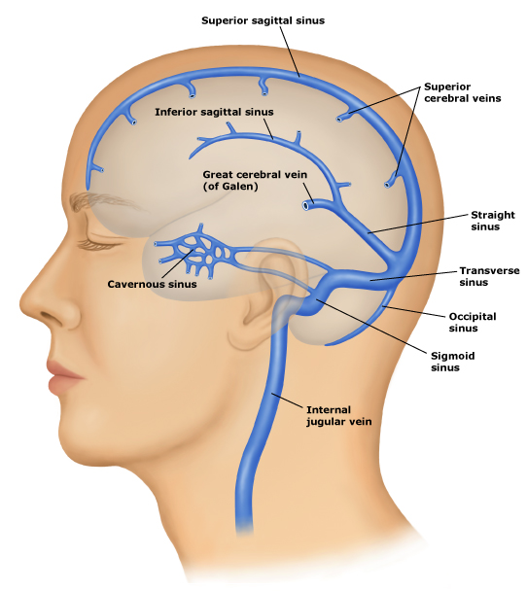
Venous Drainage of the Brain
Superior sagittal sinus
Sigmoid sinus
Great cerebral vein
Straight sinus
Confluence of the sinuses
Transverse sinus
Cavernous sinus

Slide 68
Parkinson’s Disease
Which of the following statements best describes the pathophysiology of Parkinson’s disease?
Parkinson’s disease can be caused by single gene mutations
Lewy bodies on autopsy confirms a diagnosis of Parkinson’s disease
Dopaminergic signalling in the basal ganglia is potentiated in those with the disease
Dementia is an early an prominent feature
Idiopathic Parkinson’s disease is characteristically bilateral with symmetrical motor deficits
Notes:
A
Remember TRAP
Extra-motor features

Slide 69
Parkinson’s Disease 2
Which of the following is not a clinical feature of Parkinson’s disease?
Intention tremor
Postural instability
Hypokinesia
Anosmia
Constipation
Notes:
A
Remember TRAP
Extra-motor features

Slide 70
Parkinson’s Disease
Parkinson’s disease is not the only cause of Parkinsonism
Alpha-synucleopathy
5 – 10% of cases genetic
Clinically – TRAP – tremor, rigidity, hypo/akinesia, postural instability
Extra-motor features
Treat with dopamine and dopa-decarboxylase inhibitors:
Wears off
Psychosis
Notes:
DBS

Slide 71
MND
Which of the following statements regarding motor neuron disease is false?
Motor neuron disease can be inherited through mutations in SOD1
TDP-43 aggregation is associated with motor neuron disease
Motor neuron disease specifically targets lower motor neurons
The main causes of death are aspiration and respiratory failure
An anti-glutamate drug has been shown to improve survival by three months
Notes:
C is false.

Slide 72
MND in 1 Slide
Characterised by the relatively selective degeneration of motor neurons (upper and lower)
Clinically you get mixed UMN and LMN lesion signs
Different ‘patterns’ exits: ALS, PSN, PMA
Incidence increases with age
5 – 10% of cases are genetic
Associated with cytoplasmic TDP-43 accumulation
Diagnosis to death in around 5 years
Riluzole prolongs survival by 3 months

Slide 73
MS
Which of the following statements regarding multiple sclerosis is false?
MS is an autoimmune disease in which autoantibodies form against oligodendrocyte myelin
A diagnosis of MS is made following MRI
Females are more commonly affected than males
Beta-interferon delays the onset of secondary progressive MS
Relapses can be treated with steroids
Notes:
D

Slide 74
MS in 1 Slide
Autoimmune disease of the CNS in which myelin is destroyed
Affinity for periventricular areas, the cord and eye stuff
Young adults (F>M), Association with latitude
‘Types’ include RRMS, SPMS, PPMS
Investigate with MRI +/- CSF +/- Evoked potentials
Diagnose with McDonald Criteria (dissemination in time and space)
Relapses treated with steroids
RRMS disease modifying treatments include interferon-beta, dimethyl fumerate, glatiramer acetate, fingolimod, biologics

Slide 75
Myelin
Which of the following statements regarding myelin is false?
Schwann cells are the most common type of myelination cell in the peripheral nervous system
A limitation in the study of myelination in zebrafish is that different genes are involved in the process
Myelin increases the conduction velocity of axons by facilitating saltatory conduction
Myelin provides metabolic support to axons and this metabolic support is compromised in demyelination
Biochemically, myelin produced by Schwann cells and oligodendrocytes is identical
Notes:
E

Slide 76
Neoplasia
What is the most common type of intracranial tumour?
Glioblastoma
Ependymoma
Astrocytoma
Meningioma
Metastatic tumour
Notes:
E

Slide 77
Neoplasia 2
What is the most common type of primary brain tumour?
Glioblastoma
Ependymoma
Astrocytoma
Oligodendroglioma
Medulloblastoma
Notes:
A - Worldwide, however certain ones are more common in specific places [i.e. Meningiomas represent 36.4% of all primary brain tumors, making them the most common primary brain tumor in the US]

Slide 78
Traumatic Brain Injury
Very important
Should be easy
Do the PathCAL

Slide 79
Dementia
Alzheimer’s disease
Vascular dementia
Lewy body dementia
Frontotemporal dementia

Slide 80
Epilepsy
“Much of the confusion about the classifications in epilepsy arise because of a failure to appreciate that there are two interrelated classifications: a classification of seizure type and a classification of epilepsy syndromes.”
Are you happy with epilepsy classifications?
Yes
No
Notes:
For epilepsy, I’d suggest they key things to remember are the classification systems and the drugs.

Slide 81
Classification – Seizure Type
Partial (Focal) Seizures
Generalised Seizures
By lobe:
Frontal
Temporal
Parietal
Occipital
Simple or Complex
Absences
Myoclonic seizures
Clonic seizures
Tonic seizures
Tonic/Clonic seizures
Atonic seizures
Secondary Generalised Seizure

Slide 82
Classification – Seizure Type
Davidson’s Principles and Practice of Medicine, 22nd Edition

Slide 83
ILAE Classification
Idiopathic
Symptomatic
Benign Rolandic epilepsy
Temporal lobe epilepsy
Frontal lobe epilepsy
Occipital lobe epilepsy
Focal
Lennox-Gastaut Syndrome
Childhood absence epilepsy
Juvenile myoclonic epilepsy
Generalised
Ideopathic
SOURCE: Epilepsy Lecture

Slide 84
Epilepsy - Management
Which of the following statements regarding the investigation and management of patients with a possible seizure disorder is false?
An ECG should be obtained in all patients who present with a transient loss of consciousness
Anti-convulsant drugs are not usually given till after a second seizure has occurred
Lamotrigine is a first line treatment for generalised tonic clonic epilepsy
The use of sodium valproate in pregnancy has been associated with neural tube defects
In the UK an individual with epilepsy may not drive while withdrawing from anti-convulsant medications and for 6 months following cessation of therapy
Notes:
C is false. Lamotrigine Inhibits the release of excitatory amino acids by Inhibition of sodium and calcium channels. First line for focal seizures. Main side effects are nausea, dizziness, ataxia and hypersensitivity reactions which are usually in the form of mild rashes but can be more severe. Lamotrigine also has a sedative effect. The drug may exacerbate myoclonic seizures and epilepsy.
Na valproate: Sodium valproate is effective in a wide range of seizure types and is still a first line treatment for generalised tonic clonic seizures. In young females though levetiracetam is often used as an alternative because of the teratogenic effects of sodium valproate (see below).
Adverse drug reactions:
Thinning and curling of the hair in around 10% of patients
Hepatotoxicity
Nausea
Weight gain
This drug is teratogenic and should not be used in pregnancy as it has been associated with neural tube defects.
Levetiracetam
Often referred to by its trade name Keppra®
Mechanism of action: levetiracetam is believed to function by interaction with synaptic vesicle protein 2A (SV2A) which is thought to have roles in synaptic vesicle docking and fusion.
Side effects include irritability and aggression - so called Keppra rage.
Carbamazepine seems to be most useful in the prevention of focal seizures.
Carbamazepine is a potent hepatic microsomal enzyme inducer thus the drugs has many interactions. This makes combining it with other antiepileptic treatments more complicated.
Adverse drug reactions:
Dizziness

Slide 85
Status - Management
Which of the following responses describes the earliest action that should be taken in a patient in status epilepticus?
EEG monitoring
10mg IV diazepam
15mg oral diazepam
15mg/kg IV phenytoin
Airway maintenance and oxygen administration
Notes:
E

Slide 86
Progression Graphs
The progression shown on the graph is most consistent with which of the following diseases?
Secondary progressive multiple sclerosis
Vascular dementia
Motor neuron disease
Stroke
Epilepsy
Notes:
C

Slide 87
Progression Graphs
The progression shown on the graph is most consistent with which of the following diseases?
Relapsing and remitting multiple sclerosis
Vascular disease
Motor neuron disease
Alzheimer’s disease
Glioblastoma multiforme
Notes:
A

Slide 88
Feedback
Feedback 1
Feedback 2
How useful was this:
I’d have learnt more sleeping
Marginally
Useful
Very useful
What bits did you like best?
Feedback 3
What could be improved?

Slide 89
Thanks for your attention – Good Luck!
An amended version of this presentation is already available on our website.
Please provide feedback so we can provide useful study aids!

